Slide 1
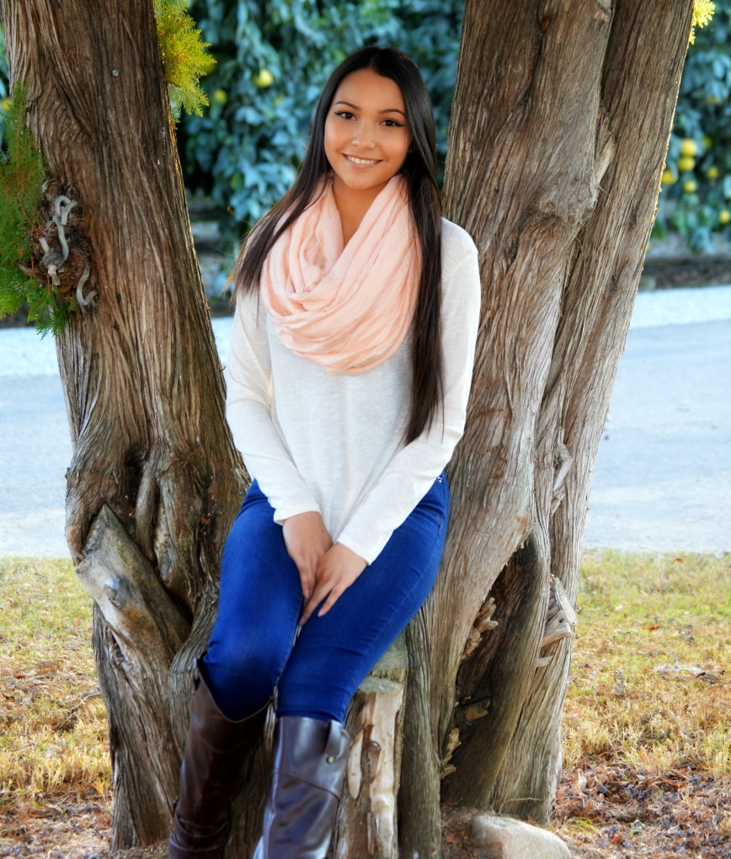
Odalys Renteria

Slide 2
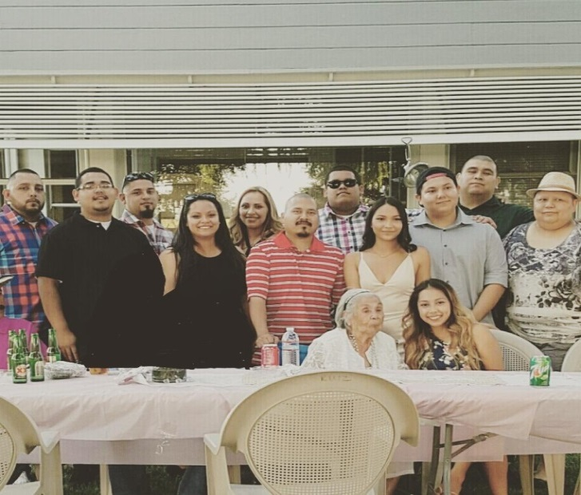
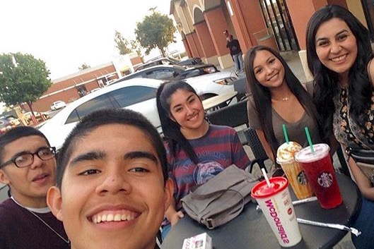
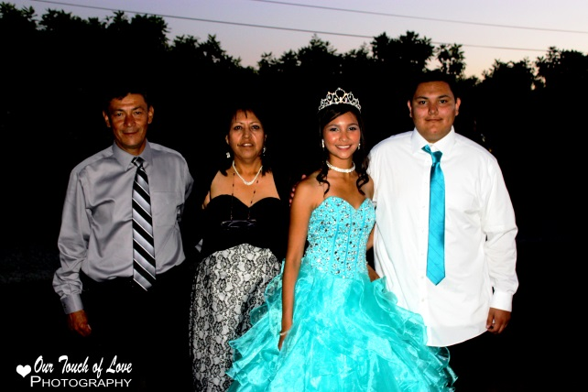
About me
I was born and raised in Lindsay, CA
My parents are Maria and Miguel Renteria
Youngest of two
Shopping is my stress reliever

Slide 3
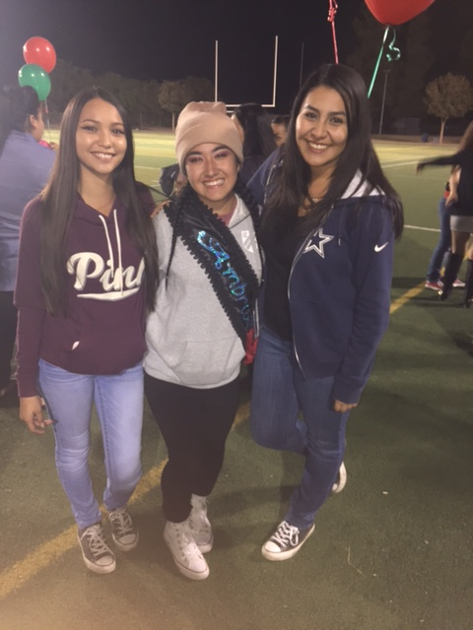
Challenges
Struggle with anxiety and depression
Frustrated with school work
Hard to manage time wisely
How did I overcome this?
Participated in FFA
Went to therapy
Prioritized school academics first
Talked to friends

Slide 4
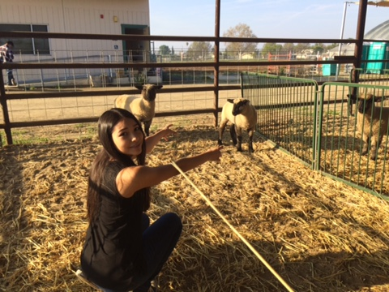
My high school experience
PBS
To be independent
Work at my own to get ahead
Club:
FFA
VET SCIENCE COMPETITION
8th grade registration
Kiddy day
Meet new people

Slide 5
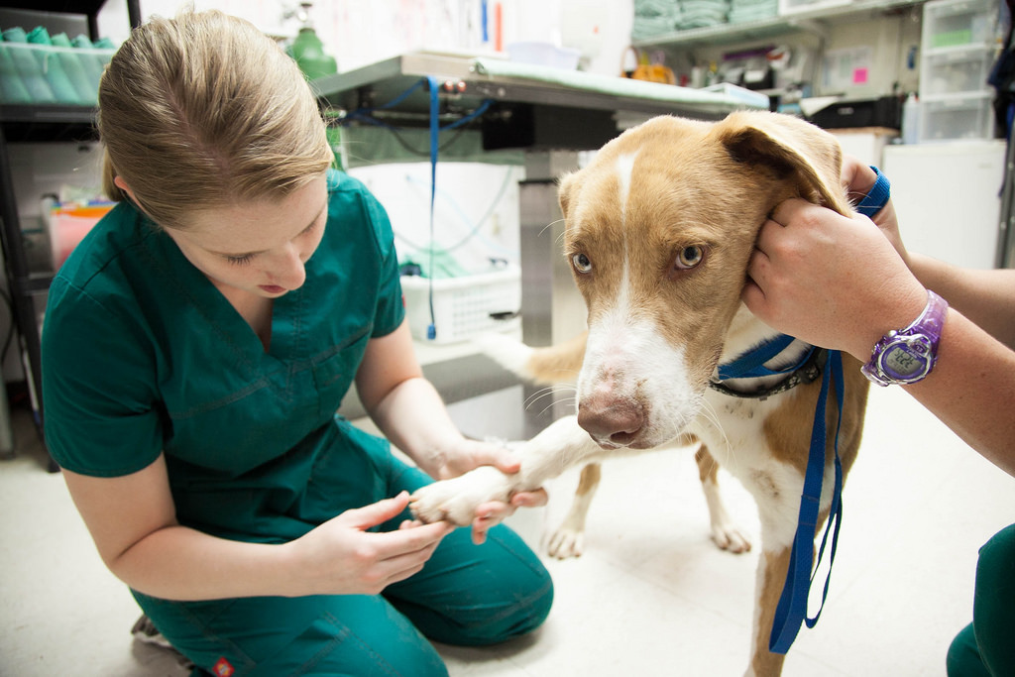
Job Shadow
Lindsay Veterinary Clinic
Vet technician- Marisol Santiago
Patient
Multitasking
Memorizing diseases, administer injections, etc.

Slide 6
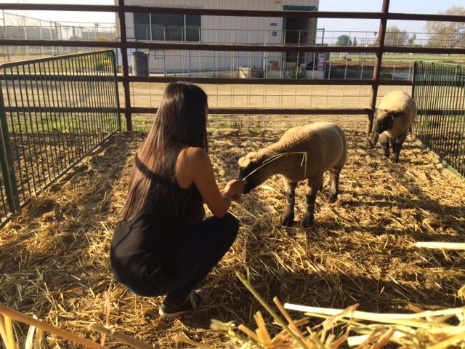
My Pathway
AGRICULTURE
Gain experience
Public speaking skills
Care for the animals
Hands on learning

Slide 7
Post-High school plans
College of the Sequoias
Support-
FAFSA
Parents
Transfer (undecided)
Part-time job
Goal: Make my parents proud

Slide 8
Leaving LHS
Be independent
BE YOURSELF!
Try new things
Make mistakes

Slide 9
THANK YOU FOR YOUR TIME!
QUESTIONS?

